Slide 1
FoodSquare
Requirement Analysis & Use Case Diagram
Masum Rahman(1505014)
Subangkar Karmaker(1505015)
Mohaimin Saquib(1505018)

Slide 2
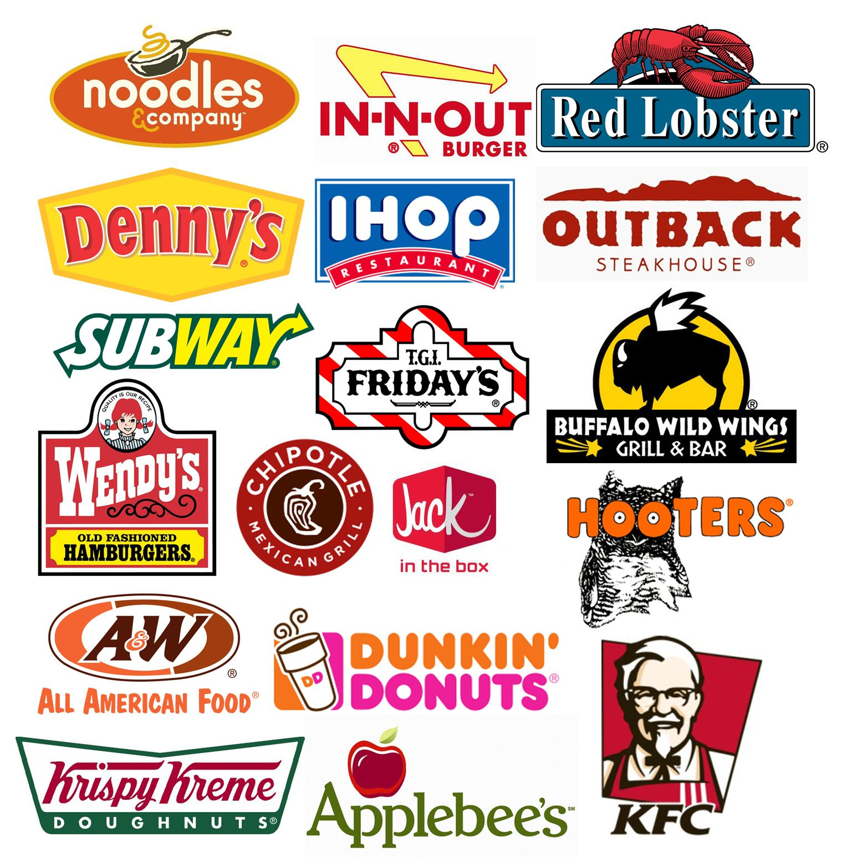
Scope Definition
The ongoing proliferation of restaurants in and outside Dhaka demands a systematic information management where customers can find a sorted view of their preferred items and restaurants.
Social Media enables customers to receive offers and review items but they are scattered in lots of pages. Hence provides no easy way for customers to deal with.

Slide 3
From the customer's point of view
Look for restaurants nearby
Look for offers for favorite items.
Check items in various restaurants easily in an organized way
Like to see and share reviews on various items in various restaurants
Like to get recommendations of items and restaurants

Slide 4
From the restaurant's point of view
Need to advertise their products
Spread out their special offers among customers
What else does a better advertisement other than a website?

Slide 5
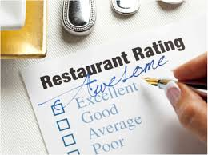
But it becomes both costly and arduous for a restaurant to maintain their own website.
Again so many restaurants are there. So it would not be so easy for restaurant authorities to spread out their business with their website.
There comes our system. This enables a restaurant to host and manage all their information in our system. Also, using our system they will be able to provide home delivery services to customers. This will create an open market for competition.

Slide 6
Customer’s Activity Flow Chart
Login
Logout
View Item
Select Payment Method
Review Restaurant/Item
Order Online

Slide 7
Restaurant Authority’s Activity Flow Chart
Login
Logout
Update Menu
Manage Order
Make Offer

Slide 8
Requirement Specification
01
View item
Search restaurant
Order food online
Book restaurant
Review item
Apply Promo in payment
Customer
02
Update Restaurant Information
Update Menu
Manage online order
Confirm booking
Make new offer
Confirm Availability
Restaurant Authority

Slide 9
Use Case Diagrams

Slide 10
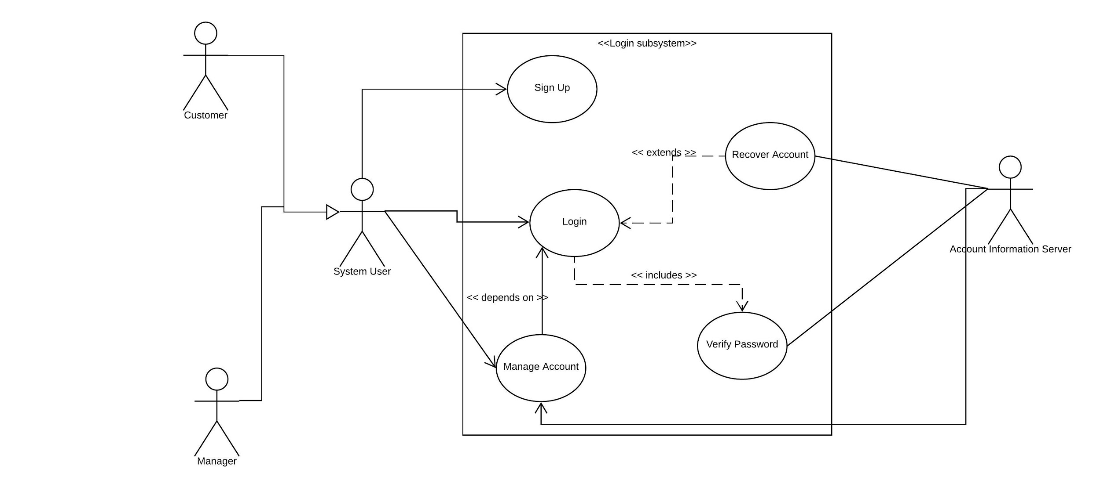

Slide 11
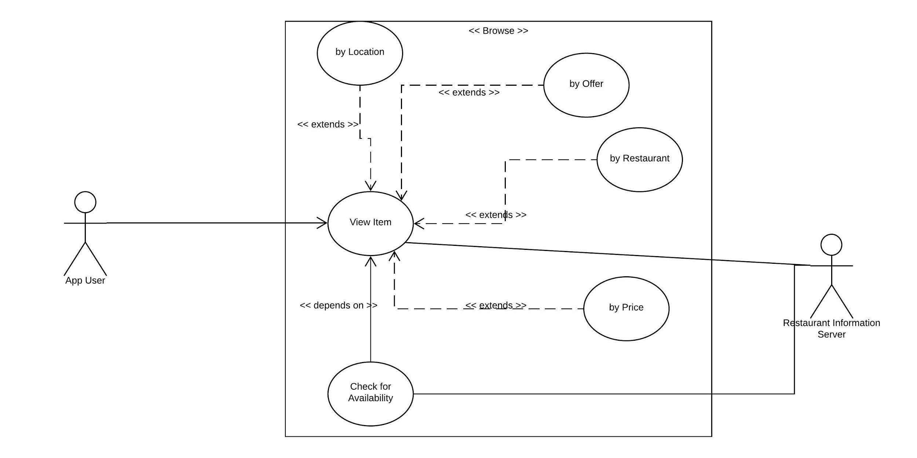

Slide 12
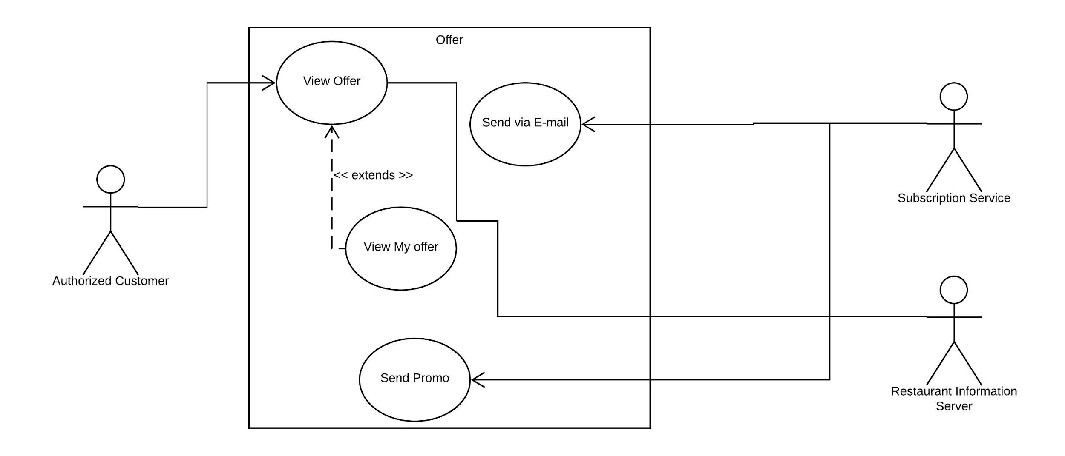

Slide 13
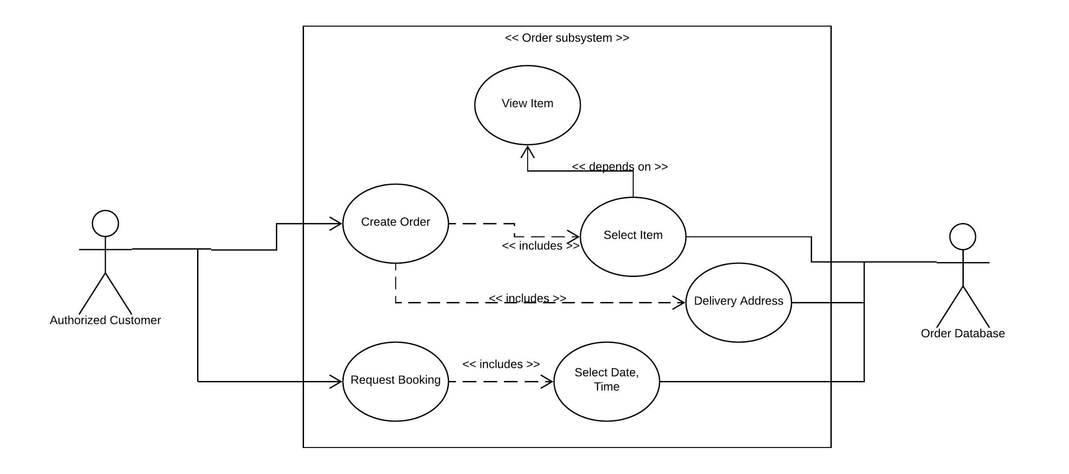

Slide 14
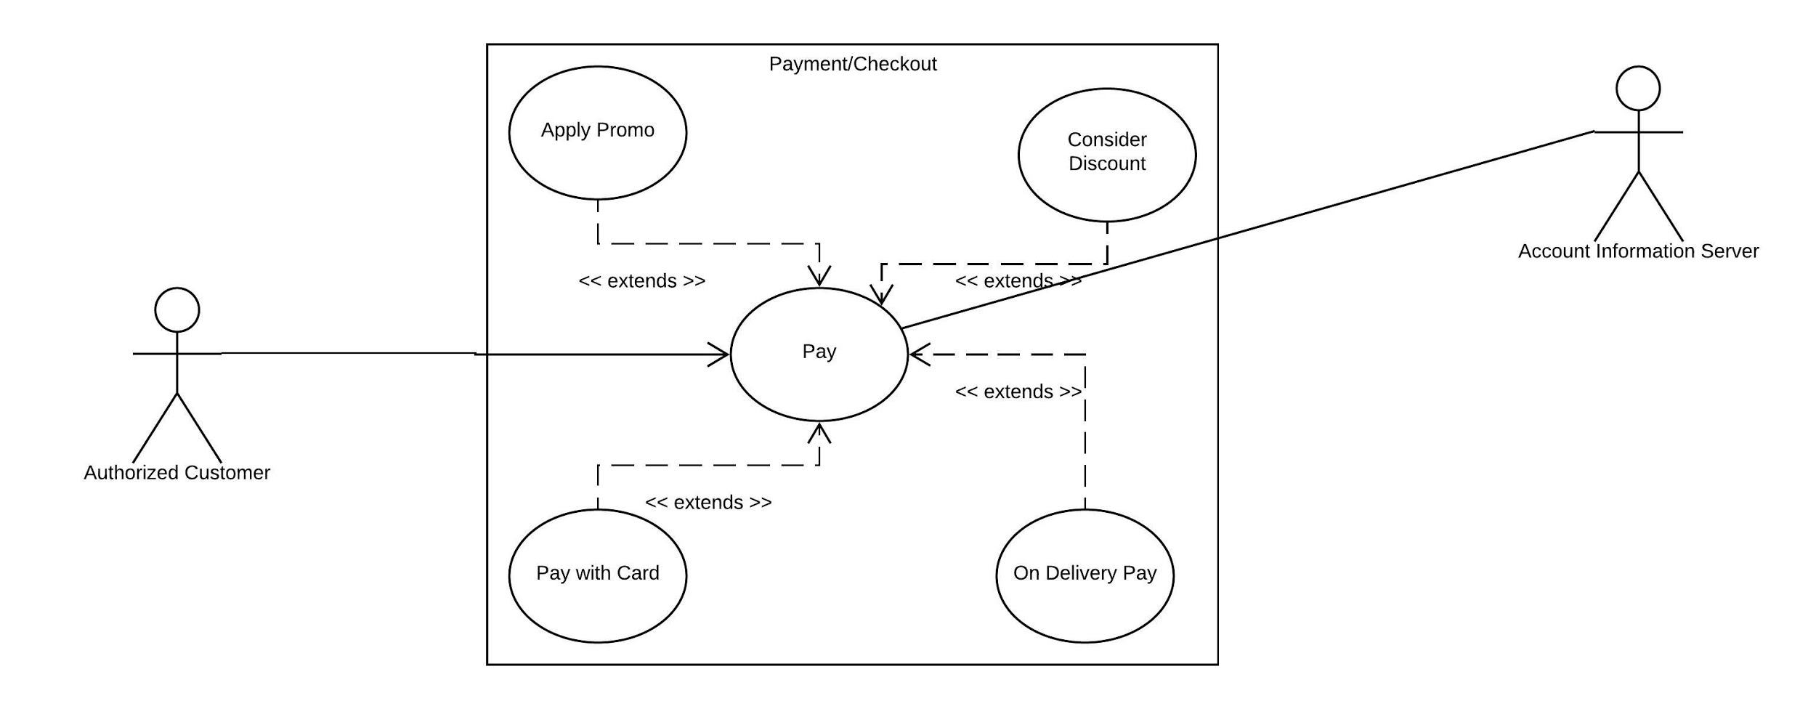

Slide 15
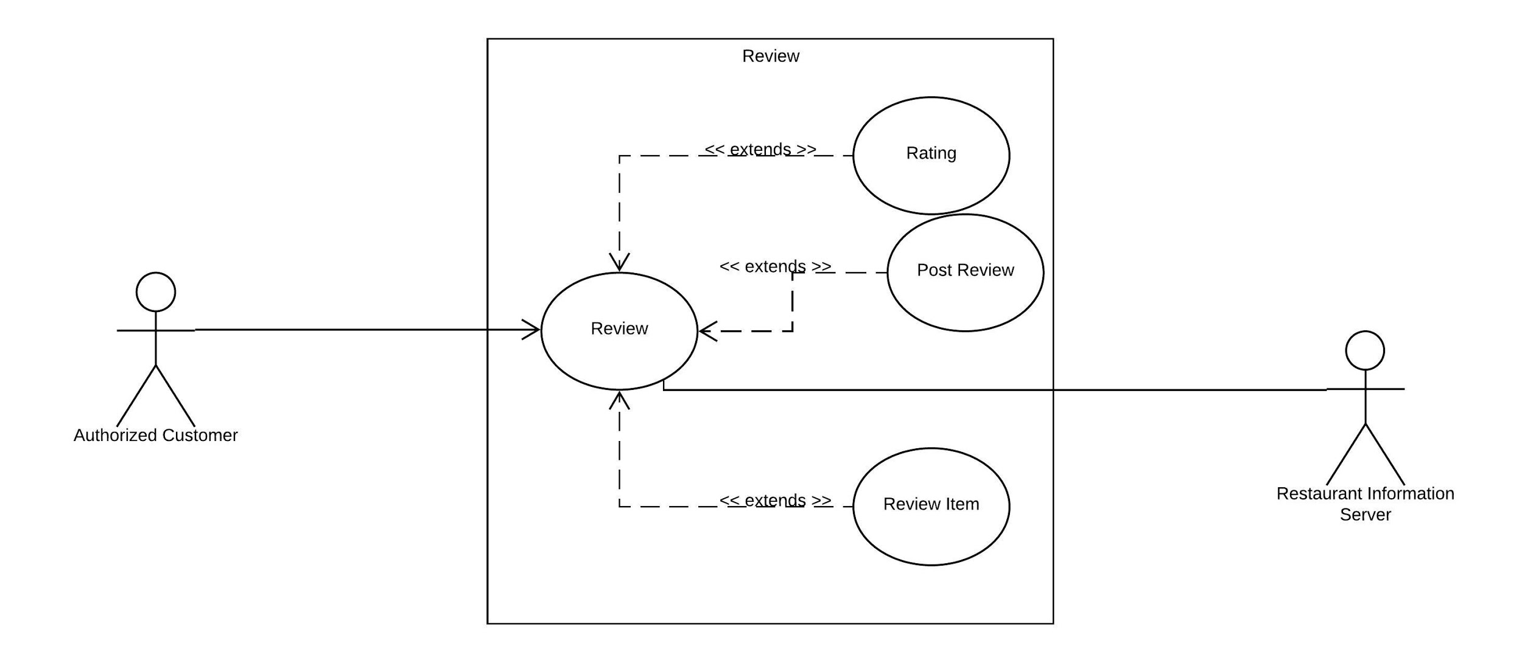

Slide 16
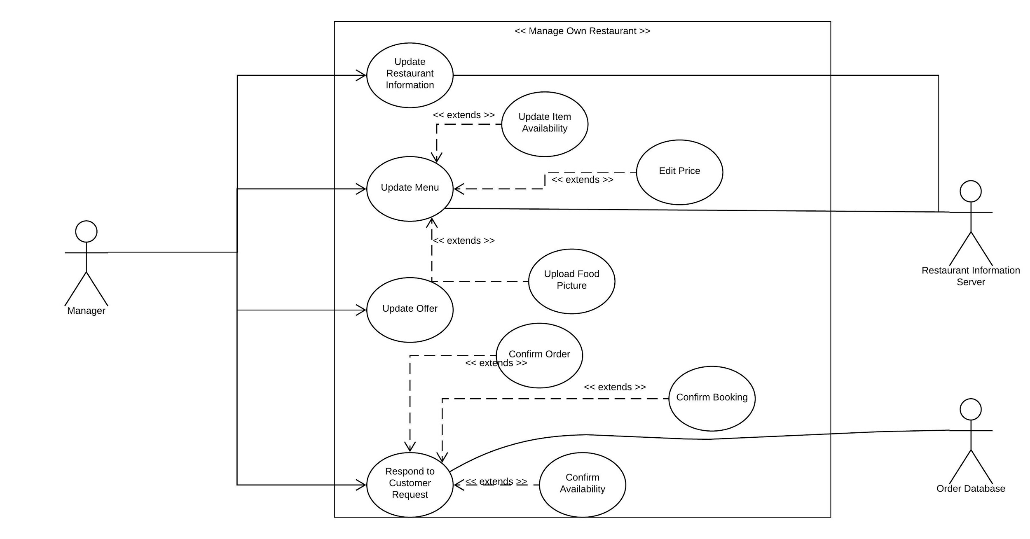

Slide 17

Thank you!

